Slide 1


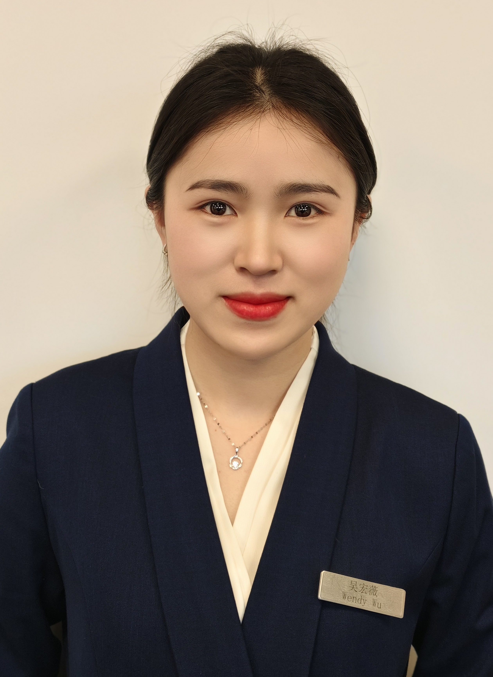
吴宏薇 Wendy
商务业绩部
吴宏薇 Wendy
商务业绩部
Welcome and enjoy your career life in IHG
Welcome and enjoy your career life in IHG

